Slide 1
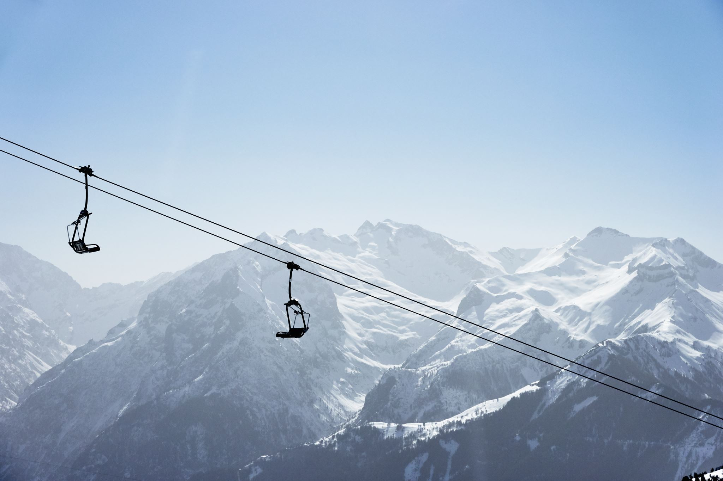
Big Mountain Resort

Slide 2

What opportunities are there for Big Mountain Resort to help offset operating costs increase of 1.5M by next year?
The resort recently installed a new chair lift that has raised operating costs by 1.5M just this season. Currently the pricing strategy has been to raise resort premiums to offset the costs, however there is not a lot data backing this strategy.
This Photo by Unknown Author is licensed under CC BY-NC

Slide 3
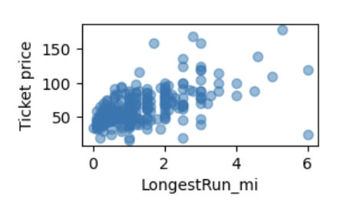
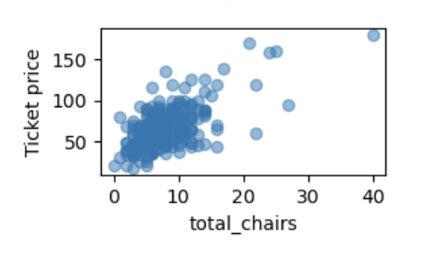
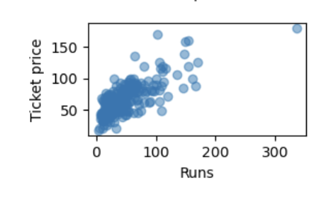
Opportunities Found
Currently Big Mountain Resort has a ticket price of 81
Its is recommended Big Mountain Resort increases price of tickets in order to close the gap created from increased operating costs. There is a strong correlation between the number of runs and average snowfall at a resort. Over all more facilities like lifts and number of chairs were related to higher ticket prices. All of which Big Mountain has plenty of compared to other resorts in the state.

Slide 4
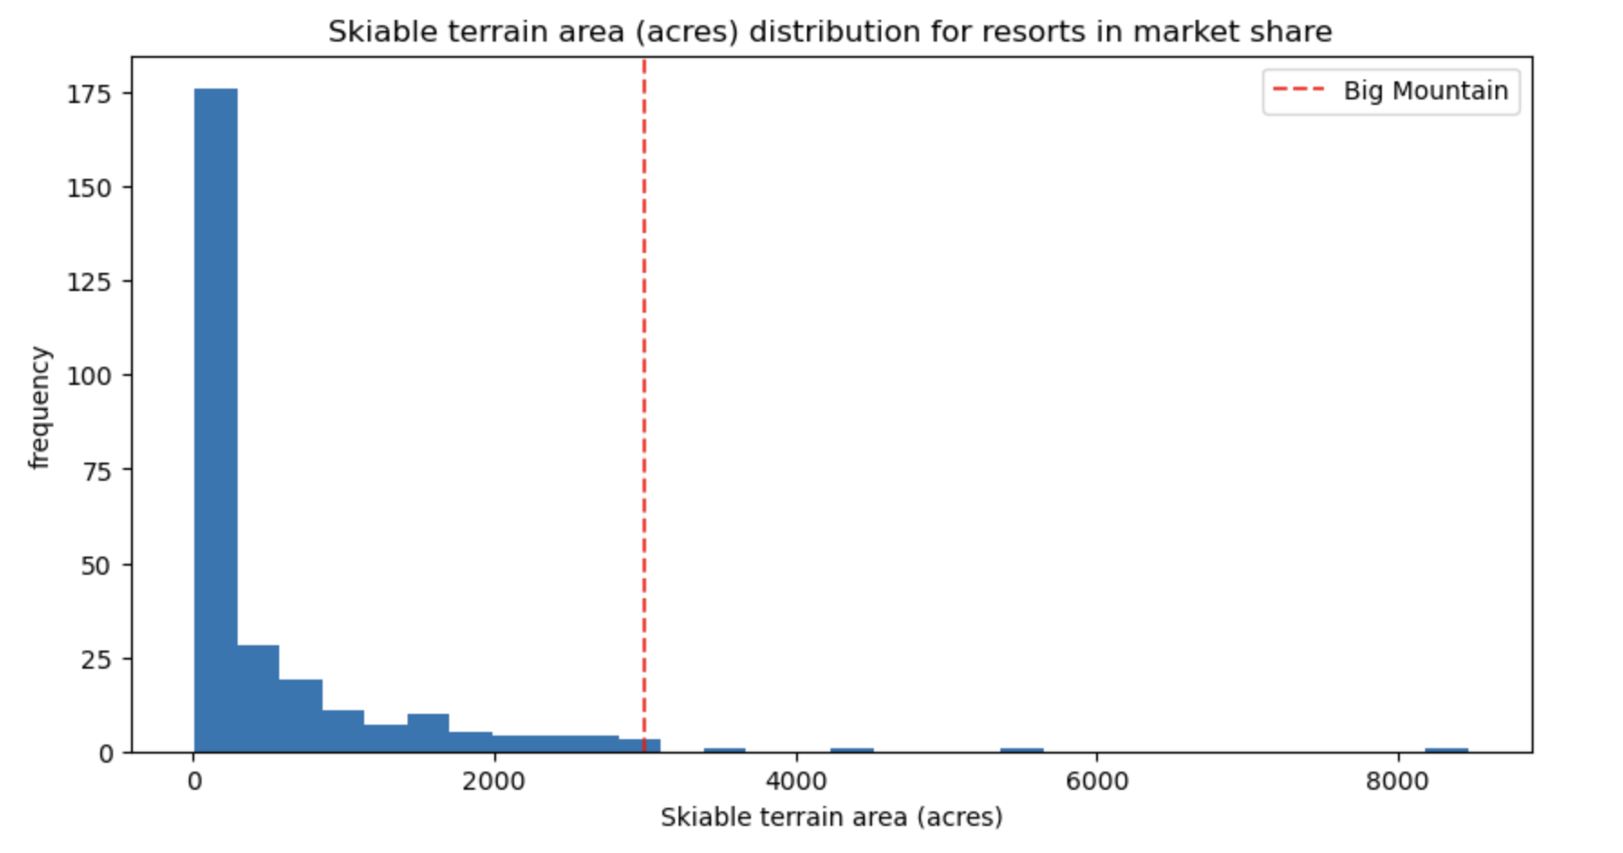
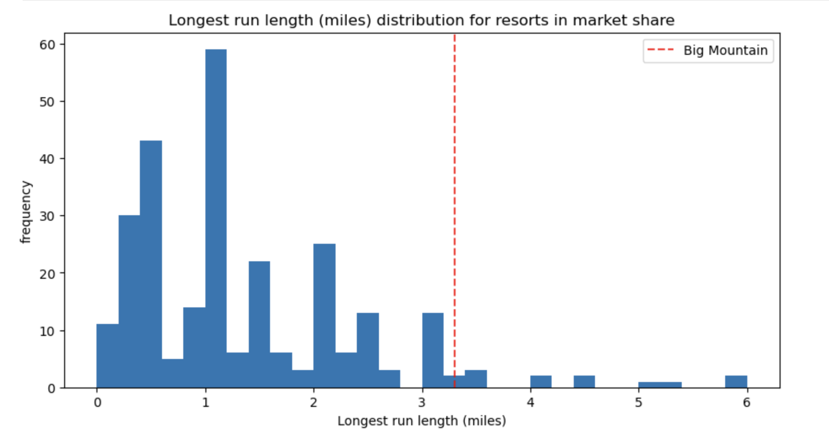
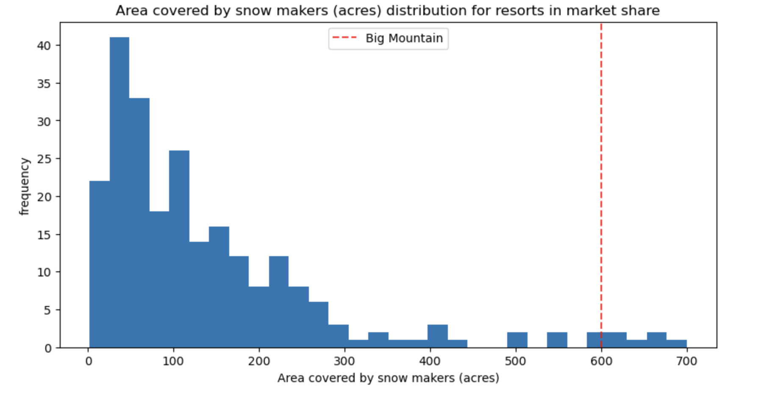
Model Findings For Resorts in Montana
Big Mountain has more snow, skiable terrain and longer runs than a majority of resorts in Montana.
This is in addition to the facilities shown in the next slide

Slide 5
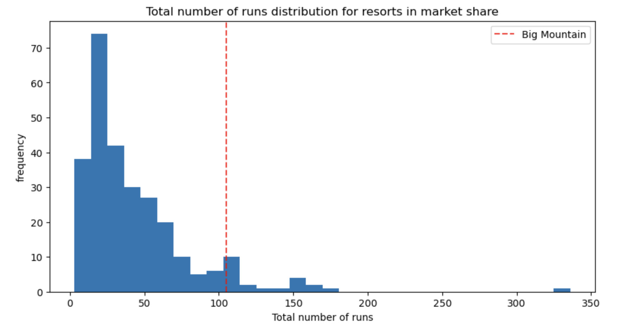
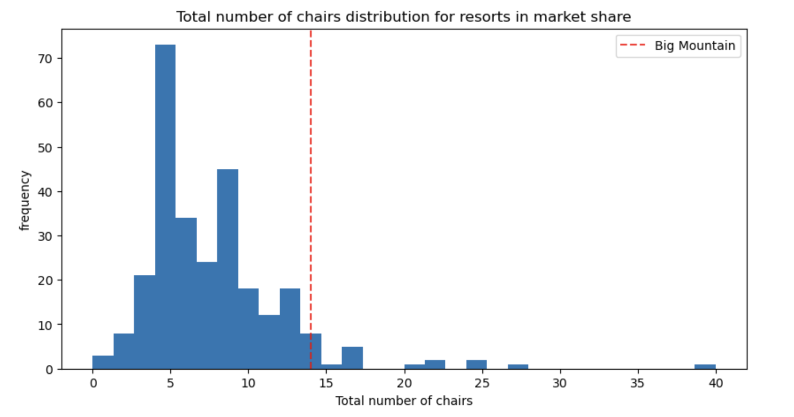
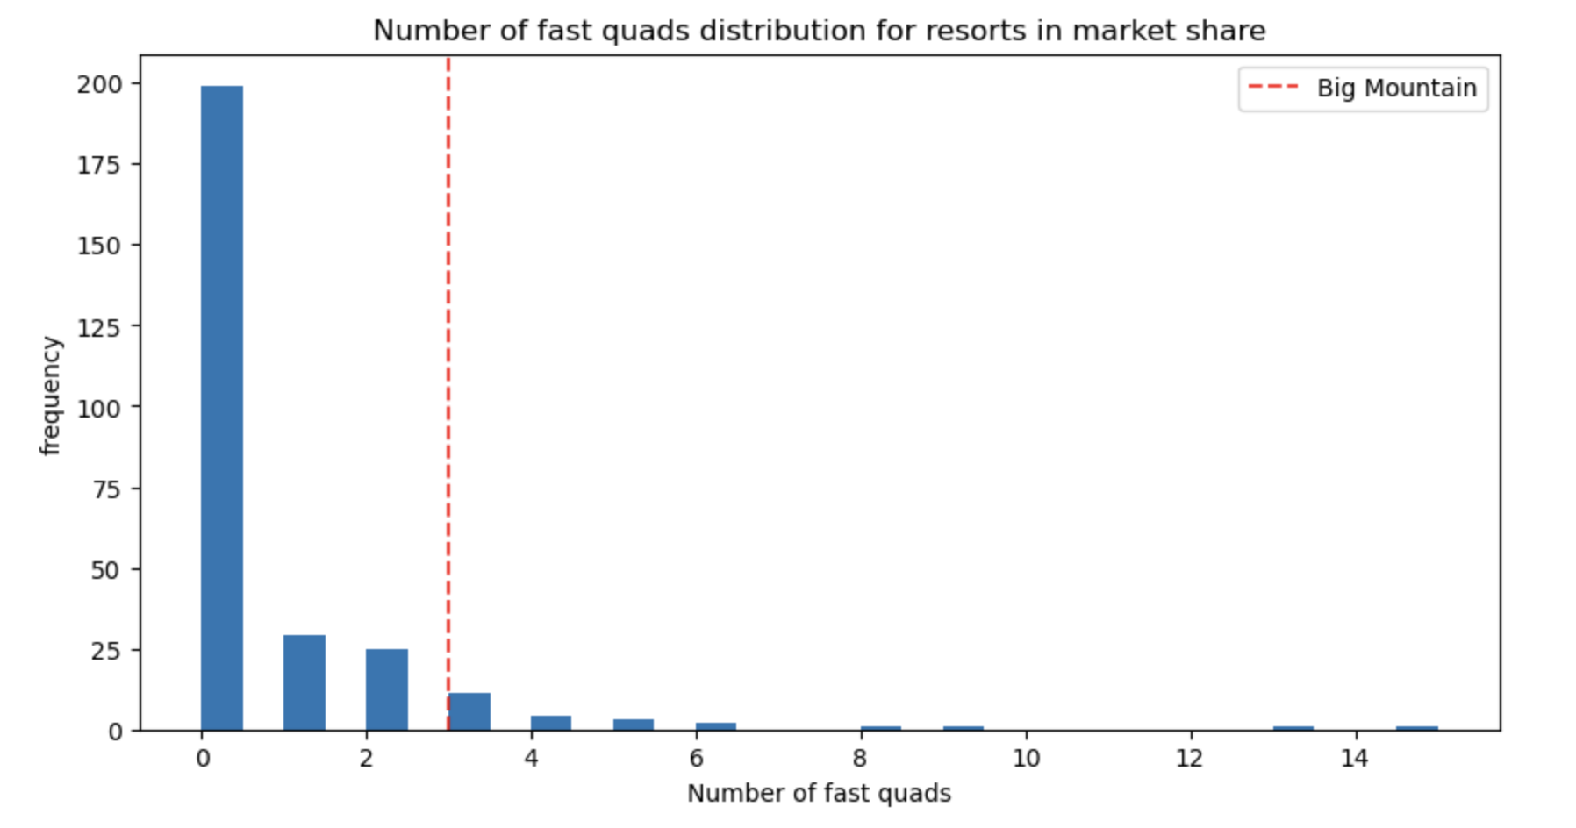
Model Findings For Resorts in Montana
Big Mountain features more chairs and facilities for getting visitors around than its competitors in the state.

Slide 6
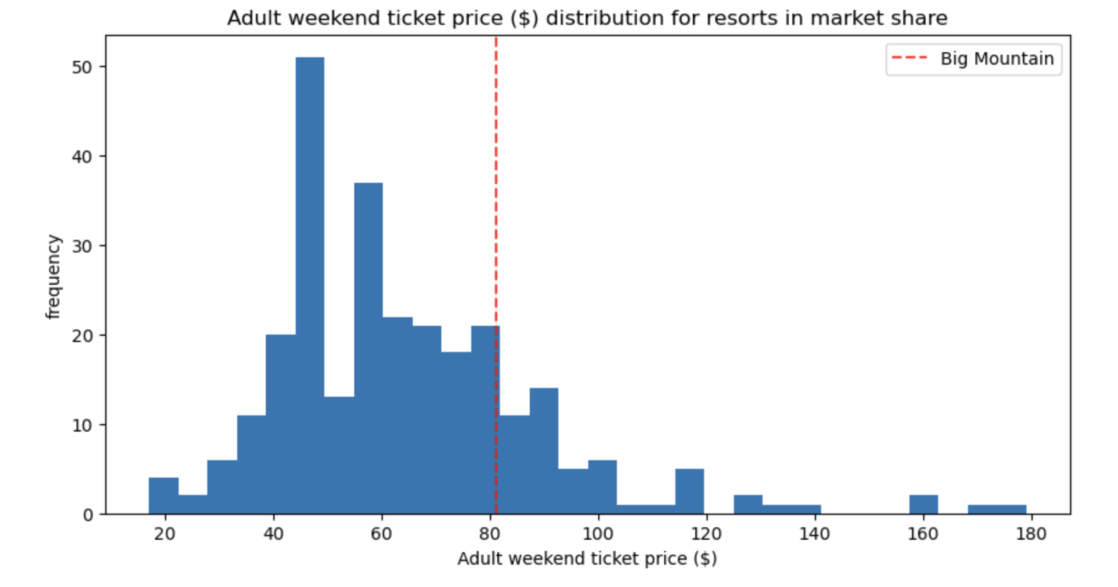
Price of Big Mountain
If Big mountain is on upper end on most features that correlate to higher ticket prices..why is the price distribution not reflected the same?

Slide 7
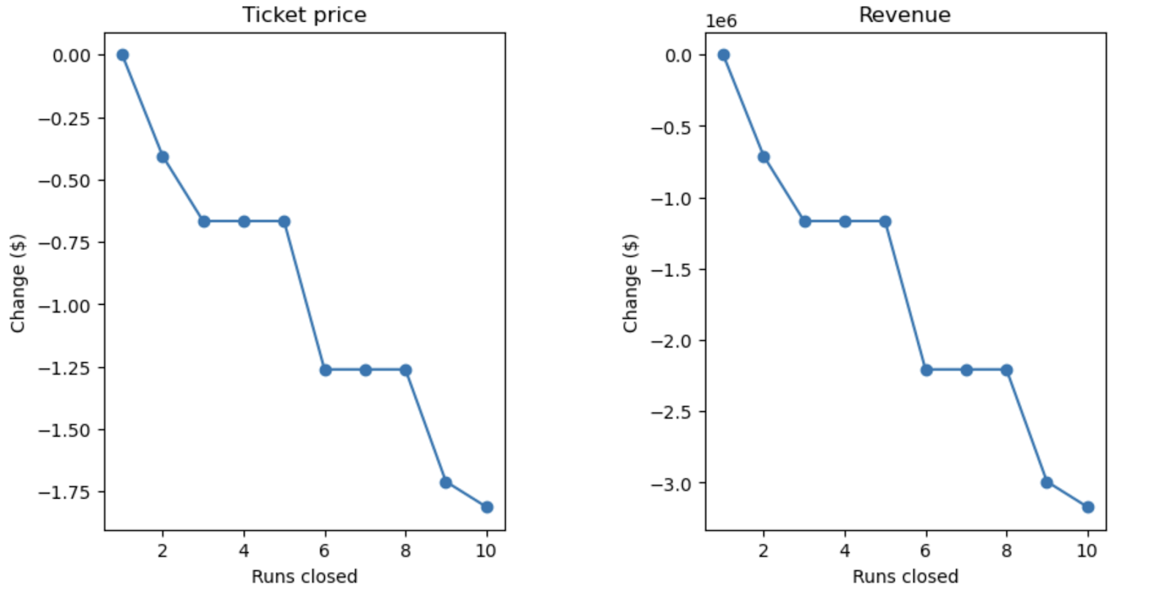
How to Pursue Higher Ticket Prices
Currently Big Mountain Resort has a ticket price of 81, our modeled price for Big Mountain Resorts is 95.87. If we assume other resorts are pricing tickets correctly, we are undervaluing our resort ticket prices. In order increase ticket prices the resort could close some runs and hedge this decrease in ticket price and build the extra lift and increase the ticket price. If 10 runs are closed the model dictates decreasing ticket price by 1.75 but if 5 runs are closed its only decrease of 0.75. So in theory you would raise the ticket price by $1.25. I’d suggest closing the runs slowly first without immediately building the new lift to see how much it affects the number of visitors per year. Then once that price is stable, build the new lift and increase the prices to match accordingly.

Slide 8
Conclusion
Big Mountain Resort is well positioned in its market share with its superior facilities, snowfall, skiable terrain. To capitalize on these superior features Big Mountain will need to adjust its prices to match the demand for those features. This will make up for increased operating costs that it is already experiencing from having these larger facilities.

